Slide 1

Revolutionising B.Tech.

Slide 2
Basics of Python Programming

Slide 3
Features of Python
Simple
Easy to Learn
Versatile
Free and Open Source
High-level Language
Interactive
Portable
Object Oriented
Interpreted
Dynamic
Extensible
Embeddable
Extensive
Easy maintenance
Secure
Robust
Multi-threaded
Garbage Collection

Slide 4
Limitations of Python
Parallel processing can be done in Python but not as elegantly as done in some other languages (like JavaScript and Go Lang).
Being an interpreted language, Python is slow as compared to C/C++. Python is not a very good choice for those developing a high-graphic 3d game that takes up a lot of CPU.
As compared to other languages, Python is evolving continuously and there is little substantial documentation available for the language.
As of now, there are few users of Python as compared to those using C, C++ or Java.
It has very limited commercial support point.
Python is slower than C or C++ when it comes to computation heavy tasks and desktop applications.
It is difficult to pack up a big Python application into a single executable file. This makes it difficult to distribute Python to non-technical.

Slide 5
Applications of Python
Embedded scripting language: Python is used as an embedded scripting language for various testing/ building/ deployment/ monitoring frameworks, scientific apps, and quick scripts.
3D Software: 3D software like Maya uses Python for automating small user tasks, or for doing more complex integration such as talking to databases and asset management systems.
Web development: Python is an easily extensible language that provides good integration with database and other web standards.
GUI-based desktop applications: Simple syntax, modular architecture, rich text processing tools and the ability to work on multiple operating systems makes Python a preferred choice for developing desktop-based applications.
Image processing and graphic design applications: Python is used to make 2D imaging software such as Inkscape, GIMP, Paint Shop Pro and Scribus. It is also used to make 3D animation packages, like Blender, 3ds Max, Cinema 4D, Houdini, Lightwave and Maya.

Slide 6
Applications of Python
Scientific and computational applications: Features like high speed, productivity and availability of tools, such as Scientific Python and Numeric Python, have made Python a preferred language to perform computation and processing of scientific data. 3D modeling software, such as FreeCAD, and finite element method software, like Abaqus, are coded in Python.
Games: Python has various modules, libraries, and platforms that support development of games. Games like Civilization-IV, Disney's Toontown Online, Vega Strike, etc. are coded using Python.
Enterprise and business applications: Simple and reliable syntax, modules and libraries, extensibility, scalability together make Python a suitable coding language for customizing larger applications. For example, Reddit which was originally written in Common Lips, was rewritten in Python in 2005. A large part of Youtube code is also written in Python.
Operating Systems: Python forms an integral part of Linux distributions.

Slide 7
Writing and Executing First Python Program
Step 1: Open an editor.
Step 2: Write the instructions
Step 3: Save it as a file with the filename having the extension .py.
Step 4: Run the interpreter with the command python program_name.py or use IDLE to run the programs.
To execute the program at the command prompt, simply change your working directory to C:\Python34 (or move to the directory where you have saved Python) then type python program_name.py.
If you want to execute the program in Python shell, then just press F5 key or click on Run Menu and then select Run Module.

Slide 8
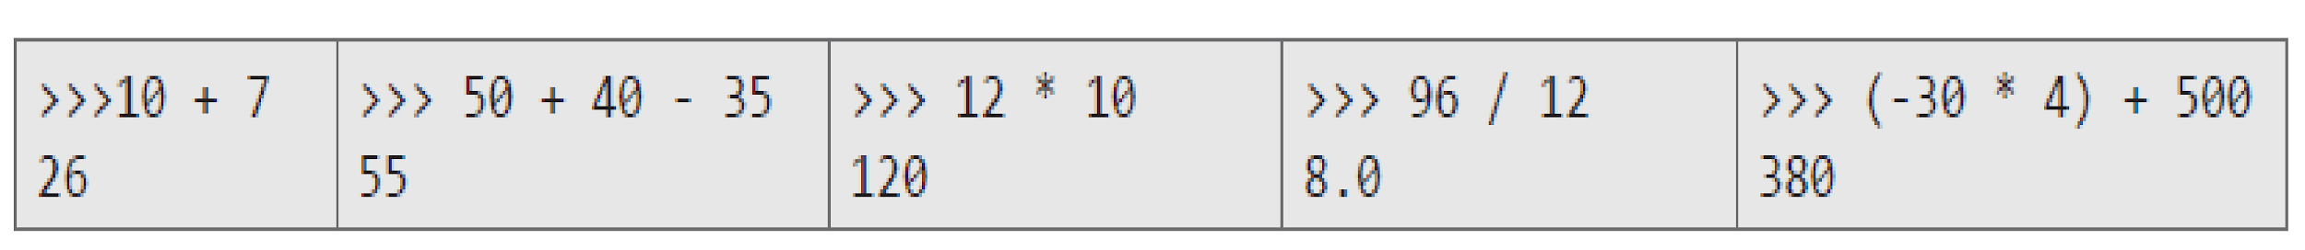
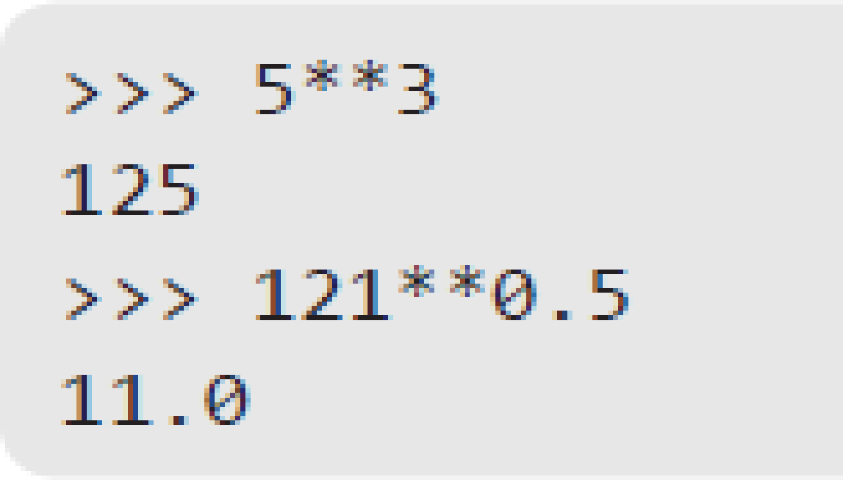
Literal Constants
The value of a literal constant can be used directly in programs. For example, 7, 3.9, 'A', and "Hello" are literal constants.
Numbers refers to a numeric value. You can use four types of numbers in Python program- integers, long integers, floating point and complex numbers.
Numbers like 5 or other whole numbers are referred to as integers. Bigger whole numbers are called long integers. For example, 535633629843L is a long integer.
Numbers like are 3.23 and 91.5E-2 are termed as floating point numbers.
Numbers of a + bi form (like -3 + 7i) are complex numbers.
Examples:

Slide 9
Literal Constants
Strings
A string is a group of characters.
Using Single Quotes ('): For example, a string can be written as 'HELLO'.
Using Double Quotes ("): Strings in double quotes are exactly same as those in single quotes. Therefore, 'HELLO' is same as "HELLO".
Using Triple Quotes (''' '''): You can specify multi-line strings using triple quotes. You can use as many single quotes and double quotes as you want in a string within triple quotes.
Examples:

Slide 10
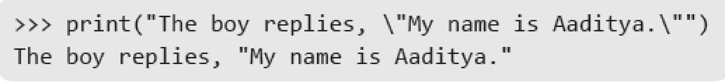
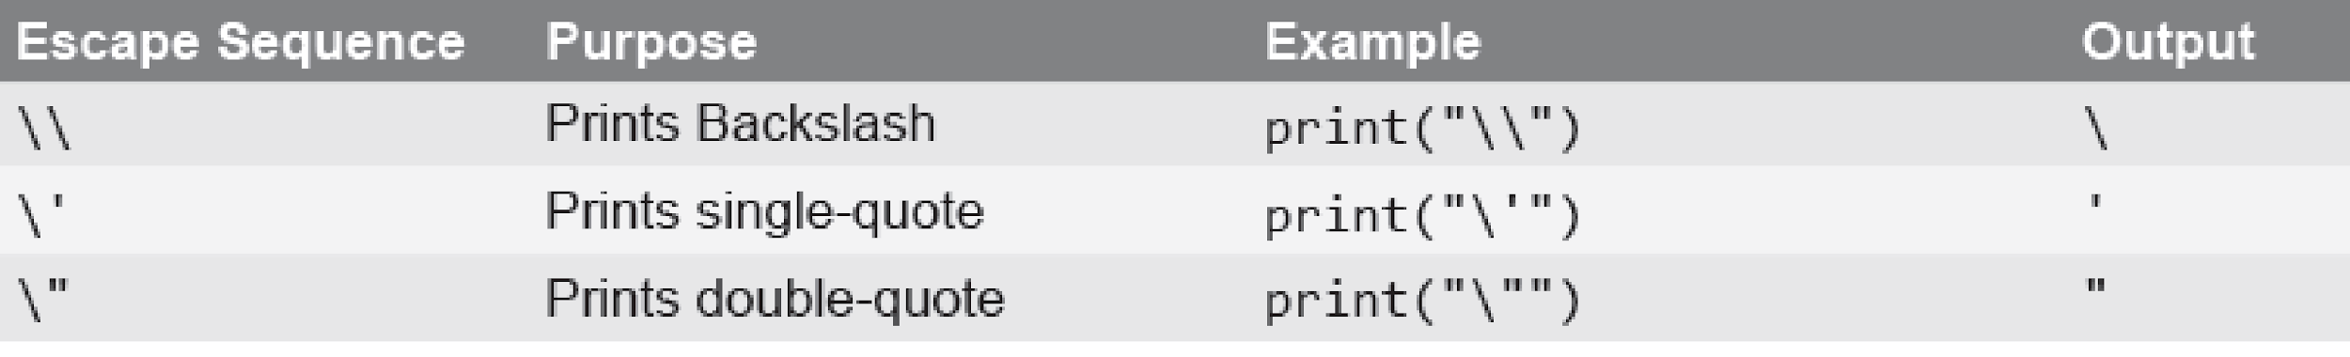
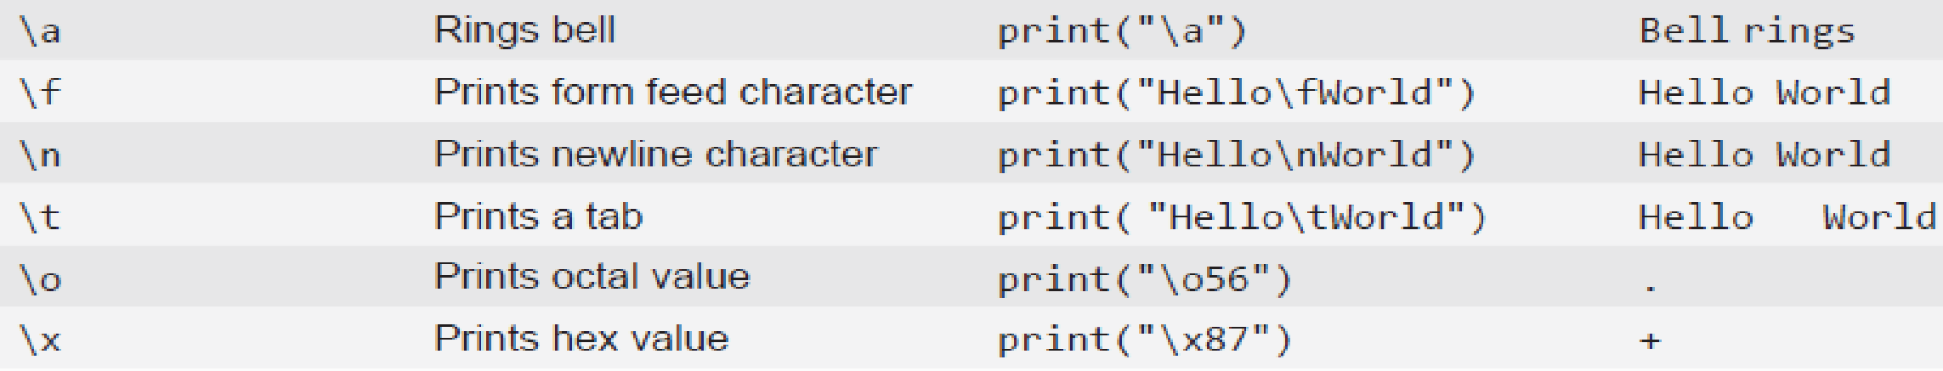
Escape Sequences
Some characters (like ", \) cannot be directly included in a string. Such characters must be escaped by placing a backslash before them.
Example:

Slide 11
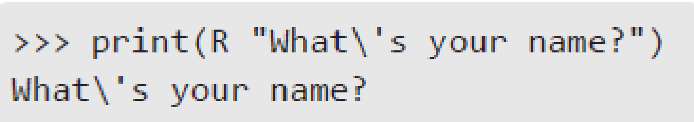
Raw Strings
If you want to specify a string that should not handle any escape sequences and want to display exactly as specified then you need to specify that string as a raw string. A raw string is specified by prefixing r or R to the string.
Example:

Slide 12
Variables and Identifiers
Variable means its value can vary. You can store any piece of information in a variable. Variables are nothing but just parts of your computer’s memory where information is stored. To be identified easily, each variable is given an appropriate name.
Identifiers are names given to identify something. This something can be a variable, function, class, module or other object. For naming any identifier, there are some basic rules like:
The first character of an identifier must be an underscore ('_') or a letter (upper or lowercase).
The rest of the identifier name can be underscores ('_'), letters (upper or lowercase), or digits (0-9).
Identifier names are case-sensitive. For example, myvar and myVar are not the same.
Punctuation characters such as @, $, and % are not allowed within identifiers.
Examples of valid identifier names are sum, __my_var, num1, r, var_20, First, etc.
Examples of invalid identifier names are 1num, my-var, %check, Basic Sal, H#R&A, etc.

Slide 13
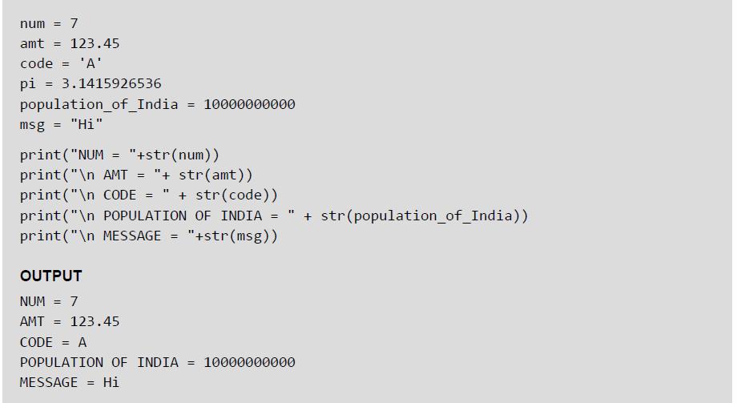
Assigning or Initializing Values to Variables
In Python, programmers need not explicitly declare variables to reserve memory space. The declaration is done automatically when a value is assigned to the variable using the equal sign (=). The operand on the left side of equal sign is the name of the variable and the operand on its right side is the value to be stored in that variable.
Example:

Slide 14
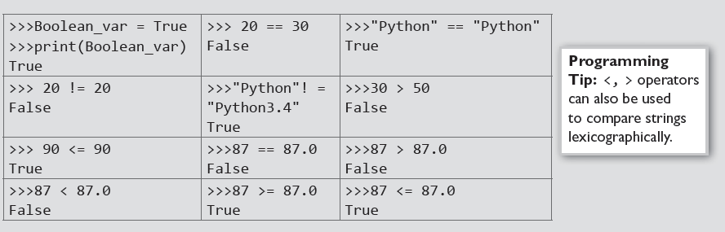
Data Type Boolean
Boolean is another data type in Python. A variable of Boolean type can have one of the two values- True or False. Similar to other variables, the Boolean variables are also created while we assign a value to them or when we use a relational operator on them.
Example:
t

Slide 15
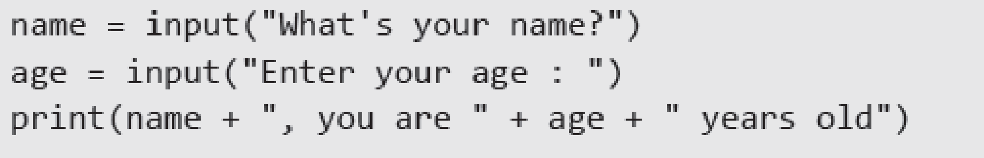
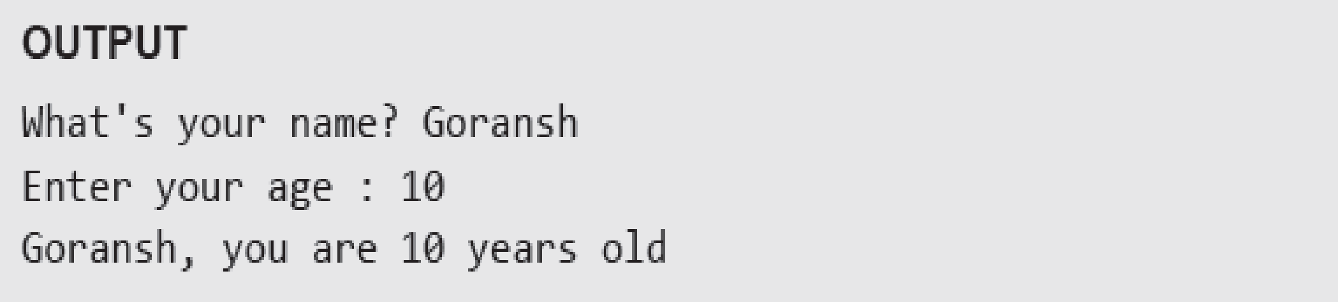
Input Operation
To take input from the users, Python makes use of the input() function. The input() function prompts the user to provide some information on which the program can work and give the result. However, we must always remember that the input function takes user’s input as a string.
Example:
t
Notes:
a

Slide 16
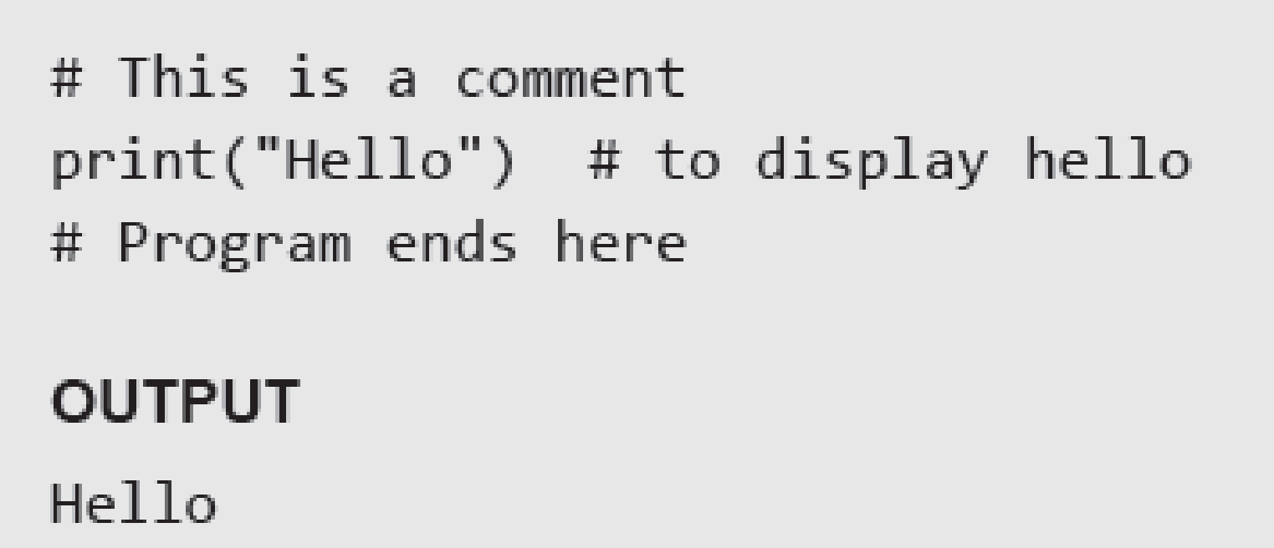
Comments
Comments are the non-executable statements in a program. They are just added to describe the statements in the program code. Comments make the program easily readable and understandable by the programmer as well as other users who are seeing the code. The interpreter simply ignores the comments.
In Python, a hash sign (#) that is not inside a string literal begins a comment. All characters following the # and up to the end of the line are part of the comment.
Example:

Slide 17
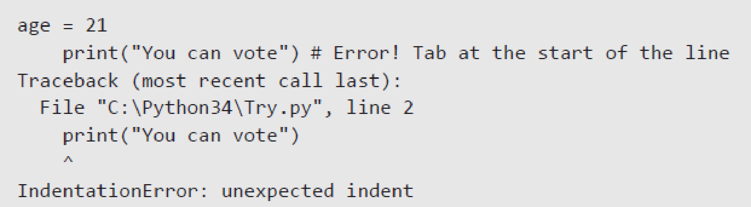
Indentation
Whitespace at the beginning of the line is called indentation. These whitespaces or the indentation are very important in Python. In a Python program, the leading whitespace including spaces and tabs at the beginning of the logical line determines the indentation level of that logical line.
Example:

Slide 18
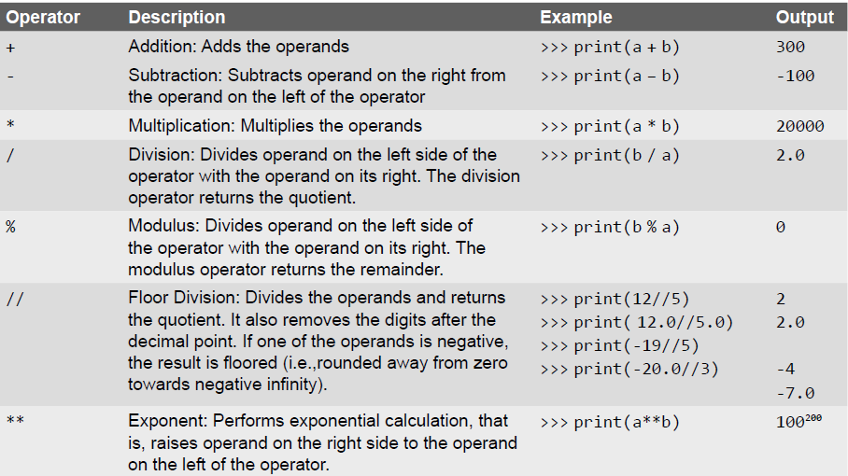
Arithmetic Operators

Slide 19
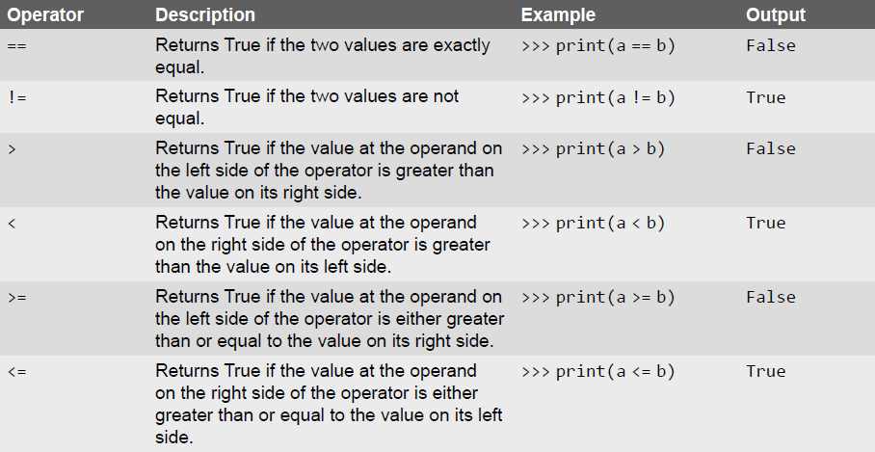
Comparison Operators

Slide 20
Unary Operators
Unary operators act on single operands. Python supports unary minus operator. Unary minus operator is strikingly different from the arithmetic operator that operates on two operands and subtracts the second operand from the first operand. When an operand is preceded by a minus sign, the unary operator negates its value.
For example, if a number is positive, it becomes negative when preceded with a unary minus operator. Similarly, if the number is negative, it becomes positive after applying the unary minus operator. Consider the given example.
b = 10 a = -(b)
The result of this expression, is a = -10, because variable b has a positive value. After applying unary minus operator (-) on the operand b, the value becomes -10, which indicates it as a negative value.

Slide 21
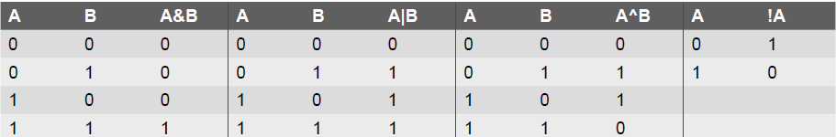
Bitwise Operators
As the name suggests, bitwise operators perform operations at the bit level. These operators include bitwise AND, bitwise OR, bitwise XOR, and shift operators. Bitwise operators expect their operands to be of integers and treat them as a sequence of bits.
The truth tables of these bitwise operators are given below.

Slide 22
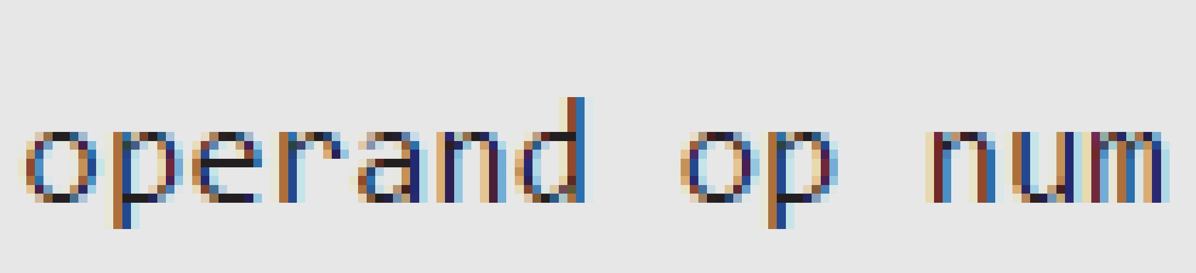
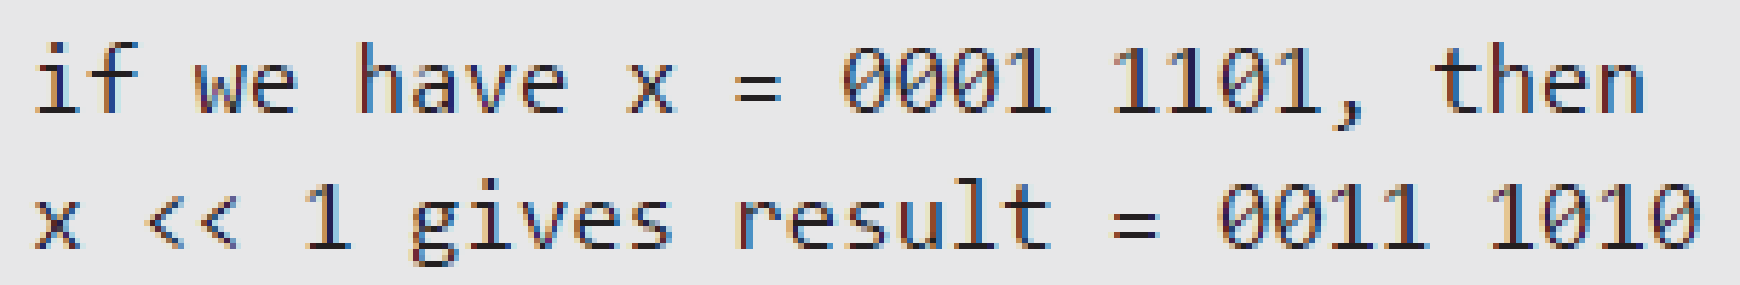
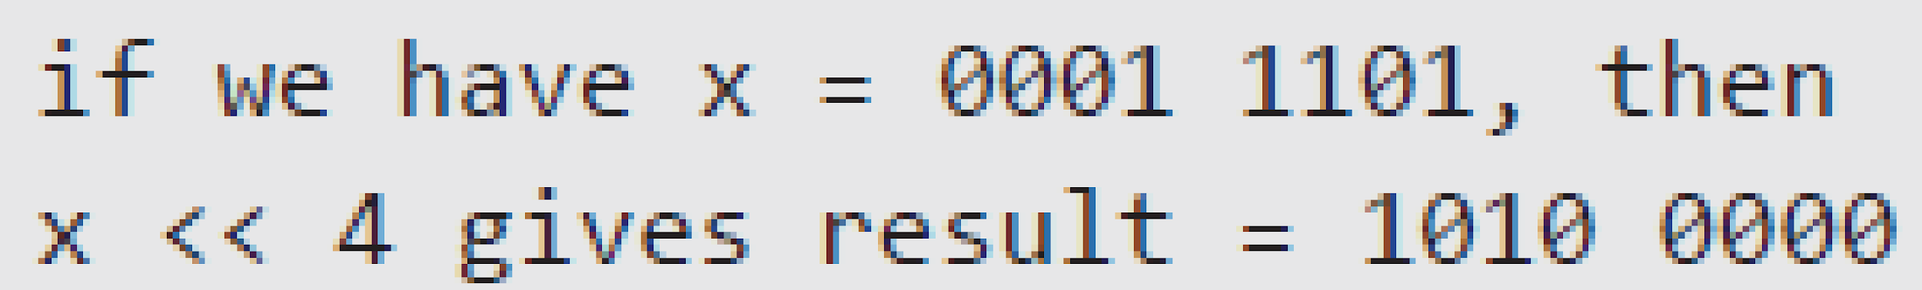
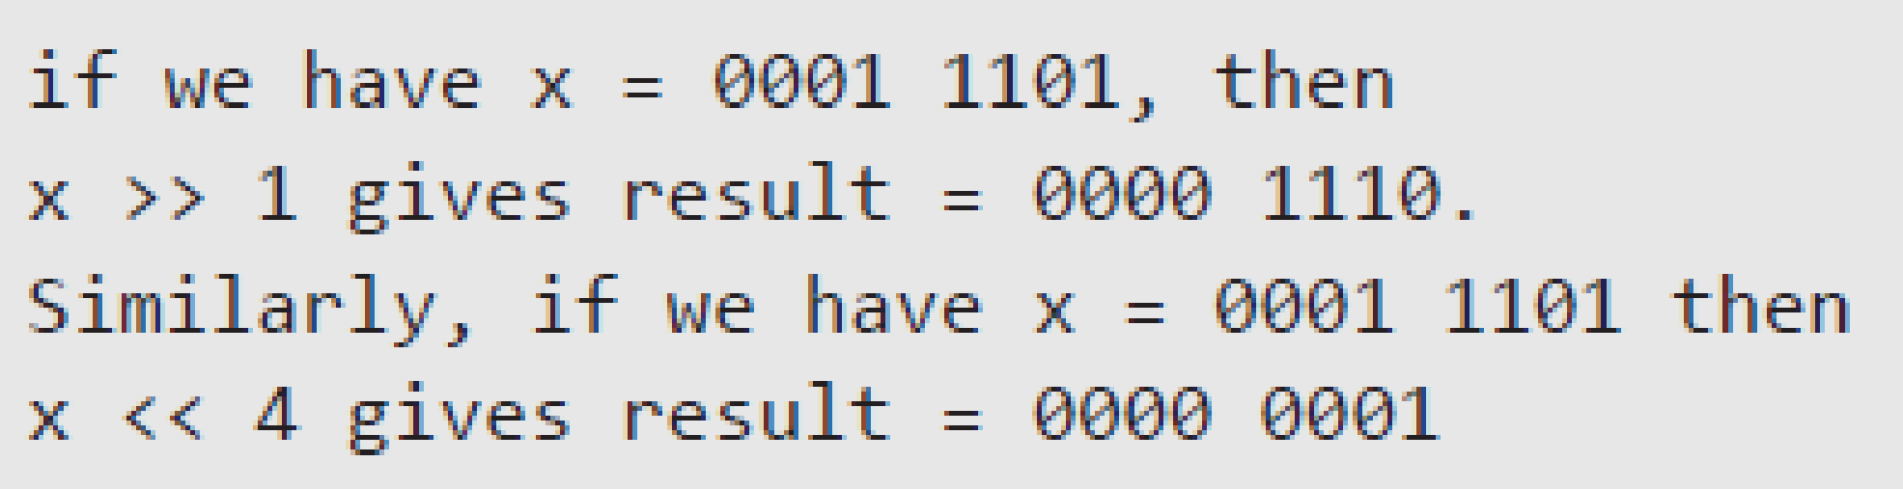
Shift Operators
Python supports two bitwise shift operators. They are shift left (<<) and shift right (>>). These operations are used to shift bits to the left or to the right. The syntax for a shift operation can be given as follows:
Examples:

Slide 23
Logical Operators
Logical AND (&&) operator is used to simultaneously evaluate two conditions or expressions with relational operators. If expressions on both the sides (left and right side) of the logical operator are true, then the whole expression is true. For example, If we have an expression (a>b) && (b>c), then the whole expression is true only if both expressions are true. That is, if b is greater than a and c.
Logical OR (||) operator is used to simultaneously evaluate two conditions or expressions with relational operators. If one or both the expressions of the logical operator is true, then the whole expression is true. For example, If we have an expression (a>b) || (b>c), then the whole expression is true if either b is greater than a or b is greater than c.
Logical not (!) operator takes a single expression and negates the value of the expression. Logical NOT produces a zero if the expression evaluates to a non-zero value and produces a 1 if the expression produces a zero. In other words, it just reverses the value of the expression. For example, a = 10, b b = !a; Now, the value of b = 0. The value of a is not zero, therefore, !a = 0. The value of !a is assigned to b, hence, the result.

Slide 24
Membership and Identity Operators
Python supports two types of membership operators–in and not in. These operators, test for membership in a sequence such as strings, lists, or tuples.
in Operator: The operator returns true if a variable is found in the specified sequence and false otherwise. For example, a in nums returns 1, if a is a member of nums.
not in Operator: The operator returns true if a variable is not found in the specified sequence and false otherwise. For example, a not in nums returns 1, if a is not a member of nums.
Identity Operators:
is Operator: Returns true if operands or values on both sides of the operator point to the same object and false otherwise. For example, if a is b returns 1, if id(a) is same as id(b).
is not Operator: Returns true if operands or values on both sides of the operator does not point to the same object and false otherwise. For example, if a is not b returns 1, if id(a) is not same as id

Slide 25
Expressions
An expression is any legal combination of symbols (like variables, constants and operators) that represents a value. In Python, an expression must have at least one operand (variable or constant) and can have one or more operators. On evaluating an expression, we get a value. Operand is the value on which operator is applied.
Constant Expressions: One that involves only constants. Example: 8 + 9 – 2
Integral Expressions: One that produces an integer result after evaluating the expression. Example: a = 10
Floating Point Expressions: One that produces floating point results. Example: a * b / 2
Relational Expressions: One that returns either true or false value. Example: c = a>b
Logical Expressions: One that combines two or more relational expressions and returns a value as True or False. Example: a>b && y! = 0
Bitwise Expressions: One that manipulates data at bit level. Example: x = y&z
Assignment Expressions: One that assigns a value to a variable. Example: c = a + b or c = 10

Slide 26
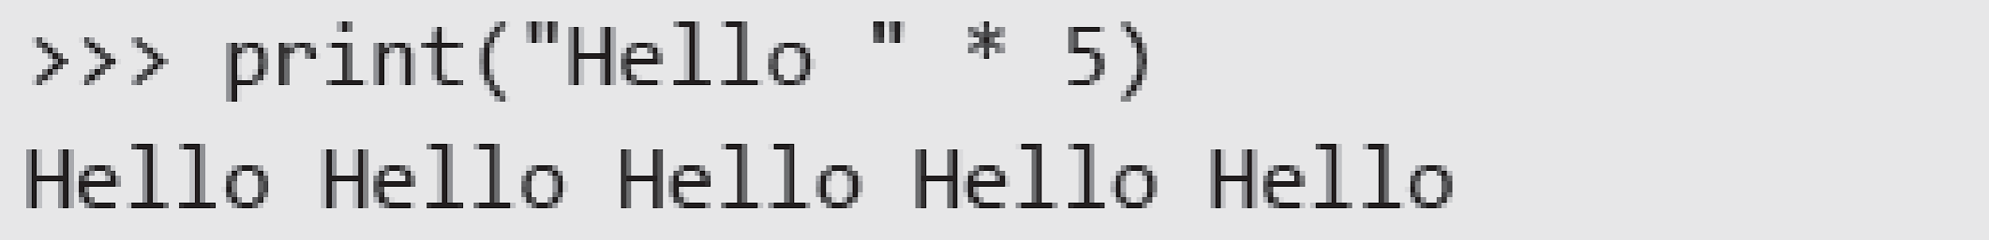
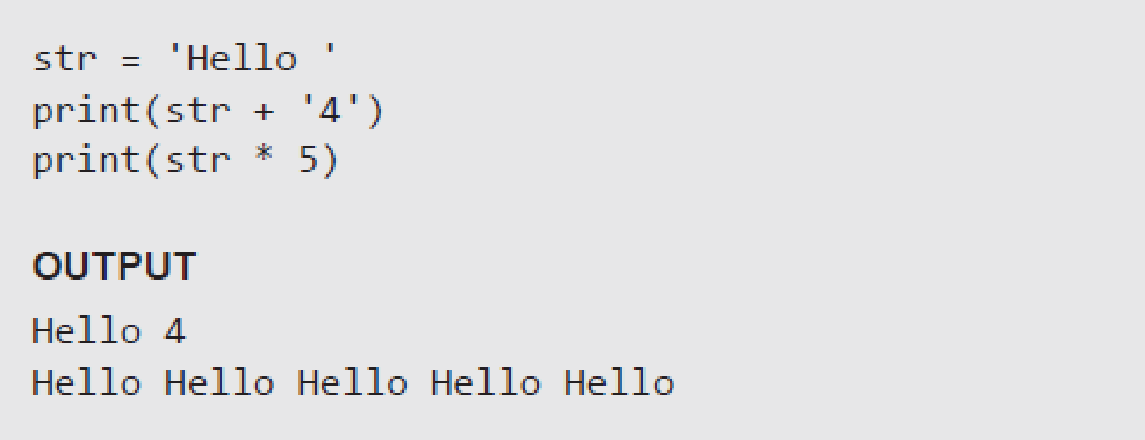
Operations on Strings
Examples:

Slide 27
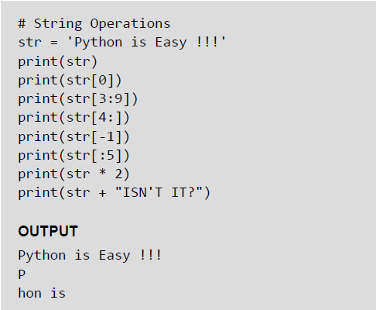
Slice Operations on Strings
You can extract subsets of strings by using the slice operator ([ ] and [:]). You need to specify index or the range of index of characters to be extracted. The index of the first character is 0 and the index of the last character is n-1, where n is the number of characters in the string.
If you want to extract characters starting from the end of the string, then you must specify the index as a negative number. For example, the index of the last character is -1.
Examples:

Slide 28
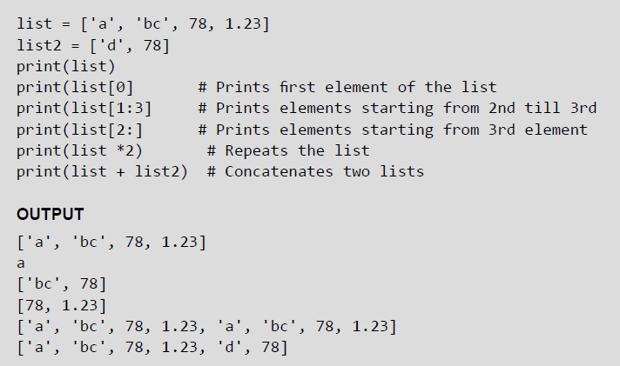
Lists
Lists are the most versatile data type of Python language. A list consist of items separated by commas and enclosed within square brackets The values stored in a list are accessed using indexes. The index of the first element being 0 and n-1 as that of the last element, where n is the total number of elements in the list. Like strings, you can also use the slice, concatenation and repetition operations on lists.
Example:

Slide 29
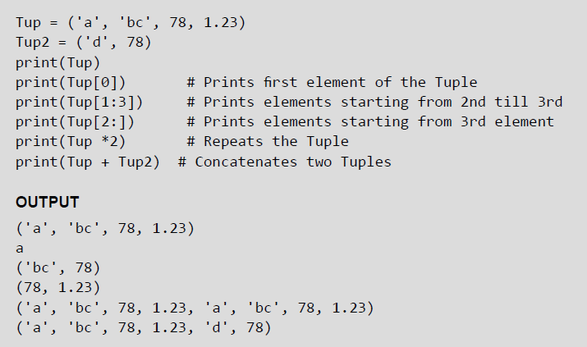
Tuples
A tuple is similar to the list as it also consists of a number of values separated by commas and enclosed within parentheses. The main difference between lists and tuples is that you can change the values in a list but not in a tuple. This means that while tuple is a read only data type, the list is not.
Example:

Slide 30
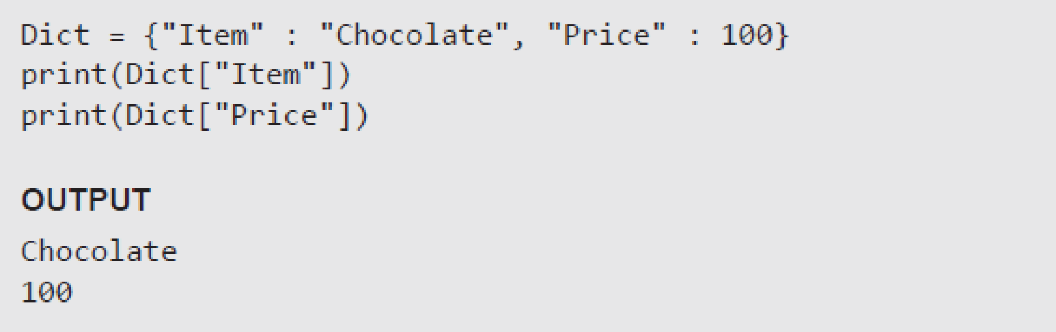
Dictionary
Python’s dictionaries stores data in key-value pairs. The key values are usually strings and value can be of any data type. The key value pairs are enclosed with curly braces ({ }). Each key value pair separated from the other using a colon (:). To access any value in the dictionary, you just need to specify its key in square braces ([]). Basically, dictionaries are used for fast retrieval of data.
Example:

Slide 31
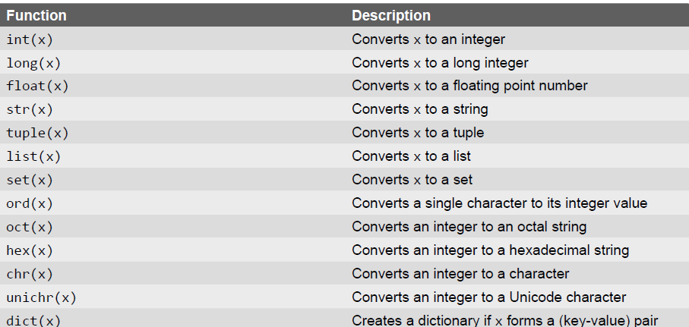
Type Conversion
In Python, it is just not possible to complete certain operations that involve different types of data. For example, it is not possible to perform "2" + 4 since one operand is an integer and the other is of string type.

Slide 32
Type Casting vs Type Coercion
In the last slide, we have done explicit conversion of a value from one data type to another. This is known as type casting.
However, in most of the programming languages including Python, there is an implicit conversion of data types either during compilation or during run-time. This is also known type coercion. For example, in an expression that has integer and floating point numbers (like 21 + 2.1 gives 23.1), the compiler will automatically convert the integer into floating point number so that fractional part is not lost.

Slide 33
Decision Control Statements

Slide 34
Control Statements
A control statement is a statement that determines the control flow of a set of instructions, i.e., it decides the sequence in which the instructions in a program are to be executed.
Types of Control Statements —
Sequential Control: A Python program is executed sequentially from the first line of the program to its last line.
Selection Control: To execute only a selected set of statements.
Iterative Control: To execute a set of statements repeatedly.

Slide 35
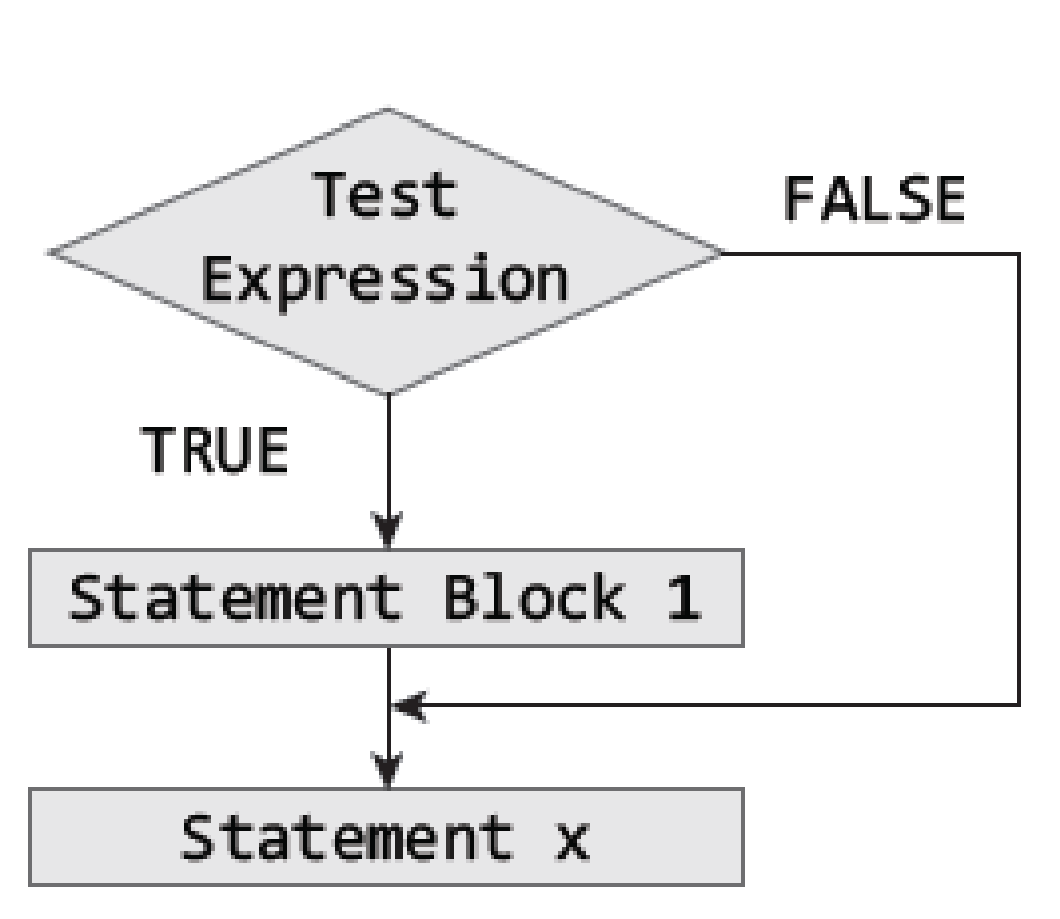
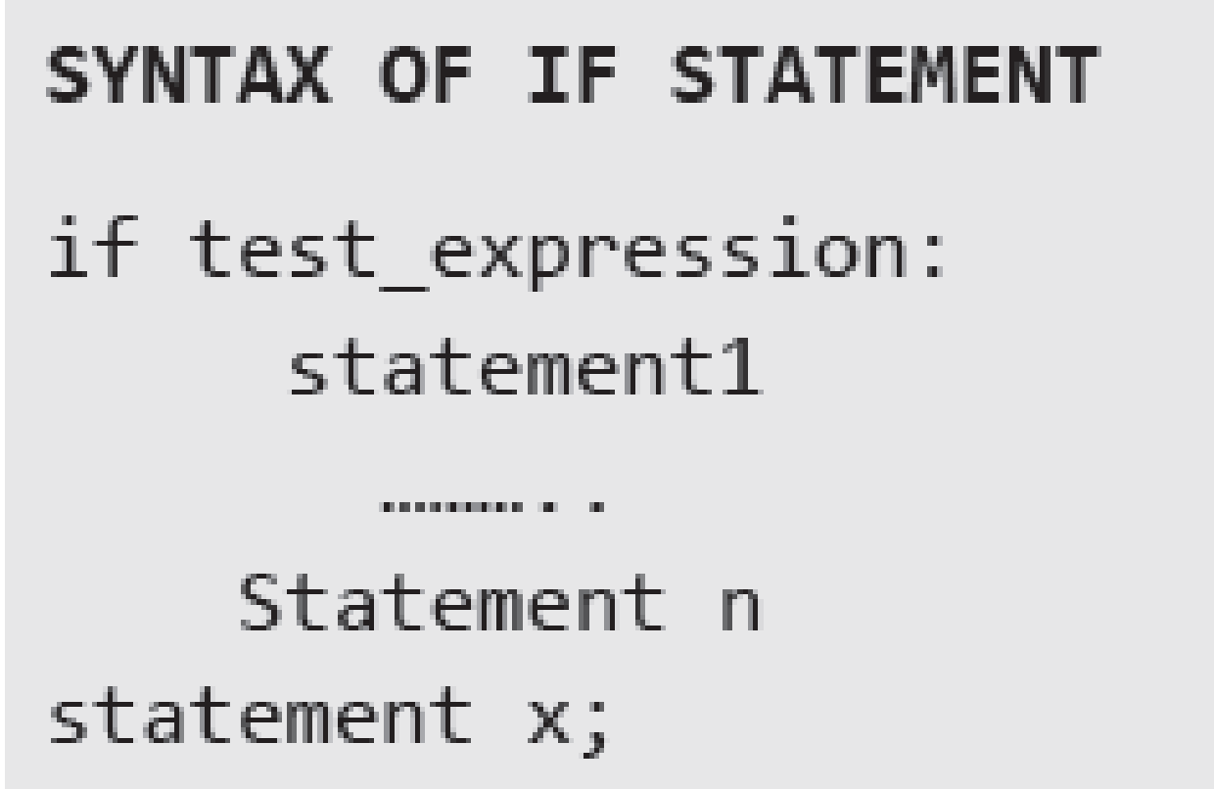
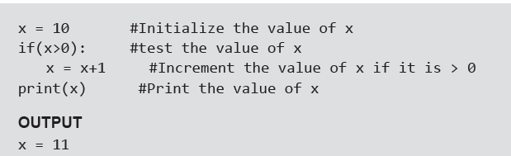
If Statement
Example:

Slide 36
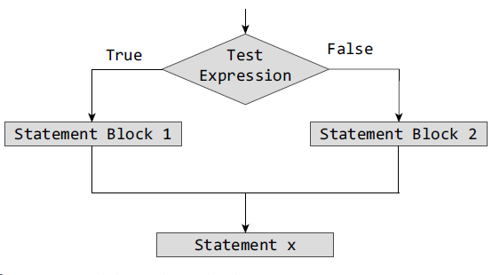
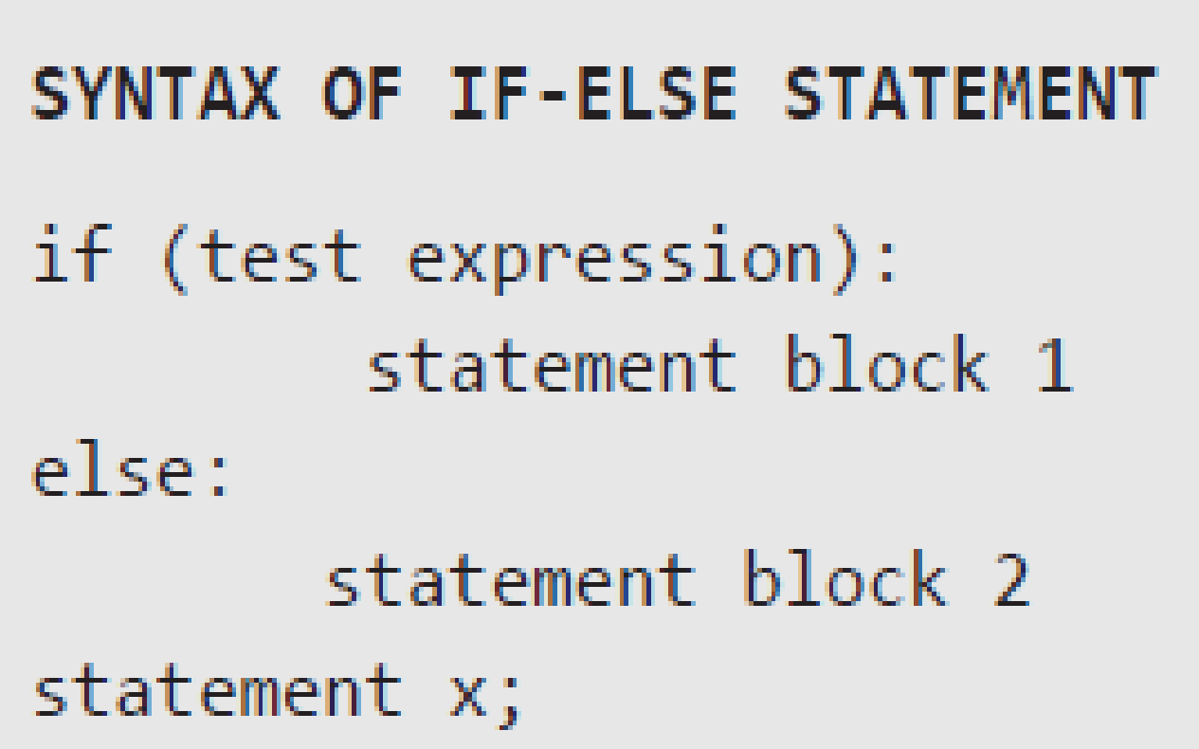
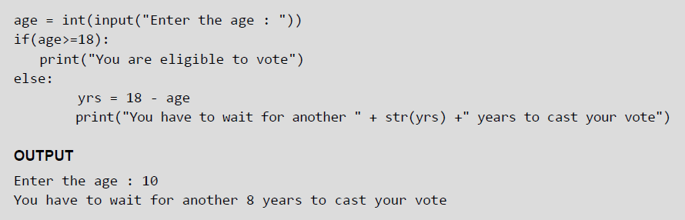
If-Else Statement
Example:

Slide 37
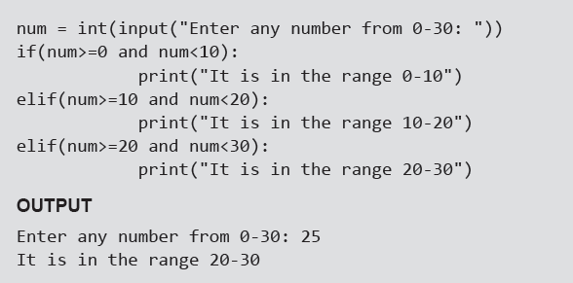
Nested if Statement
A statement that contains other statements is called a compound statement. To perform more complex checks, if statements can be nested, that is, can be placed one inside the other. In such a case, the inner if statement is the statement part of the outer one. Nested if statements are used to check if more than one conditions are satisfied.
Example:

Slide 38
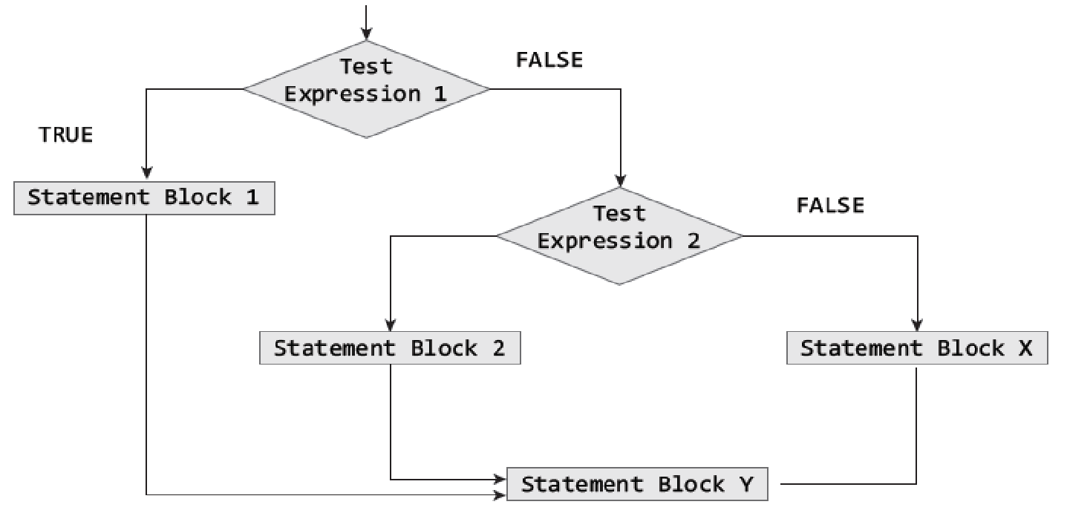
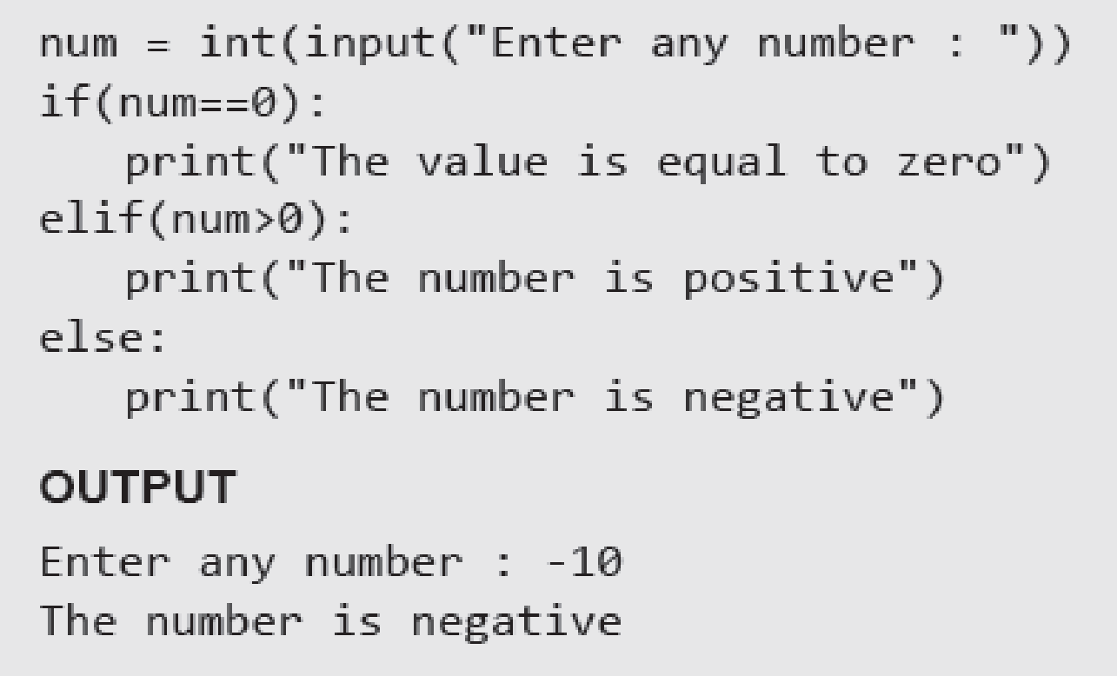
If-elif-else Statement
Python supports if-elif-else statements to test additional conditions apart from the initial test expression. The if-elif-else construct works in the same way as a usual if-else statement. If-elif-else construct is also known as nested-if construct.
Example:

Slide 39
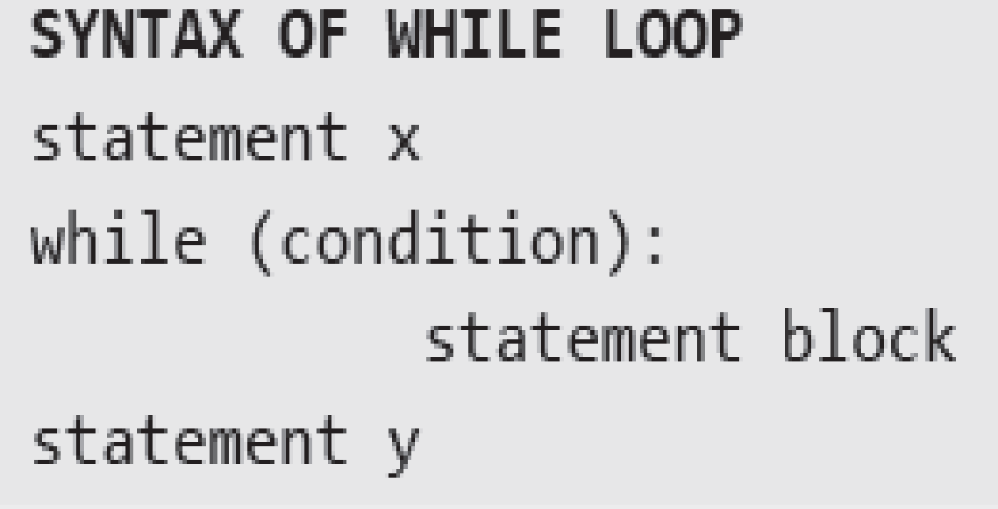
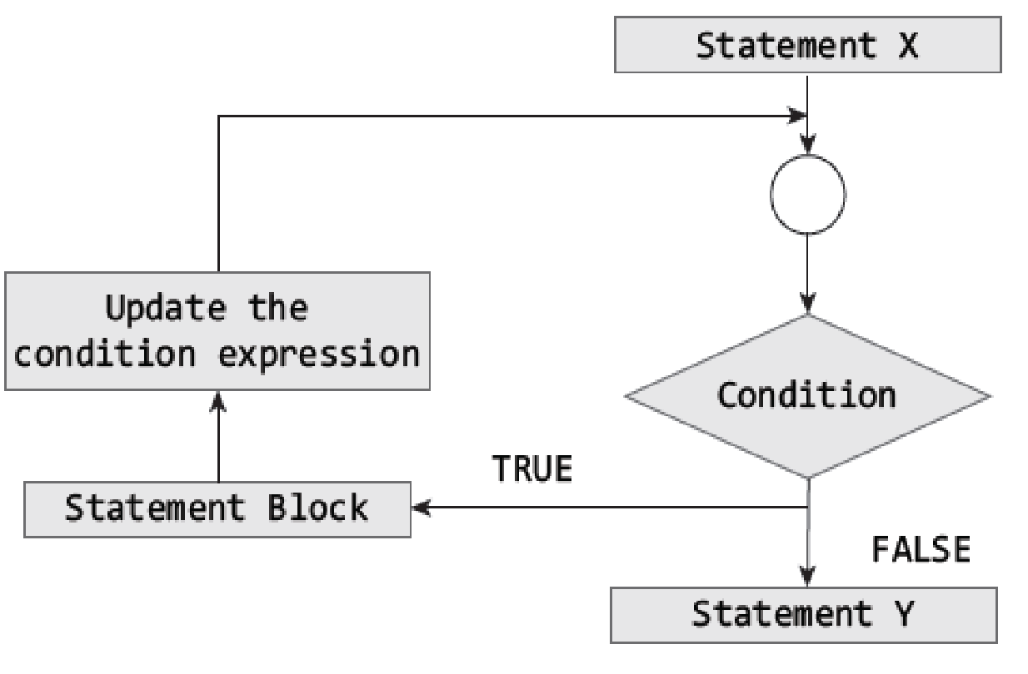
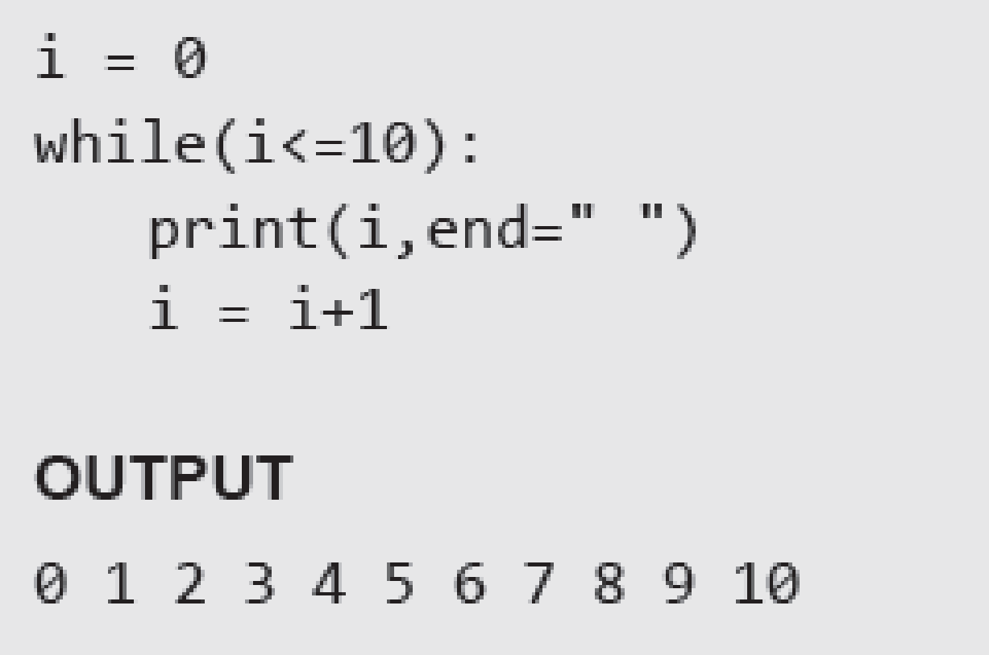
While Loop
Example:

Slide 40
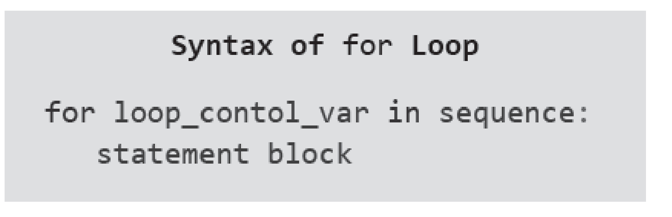
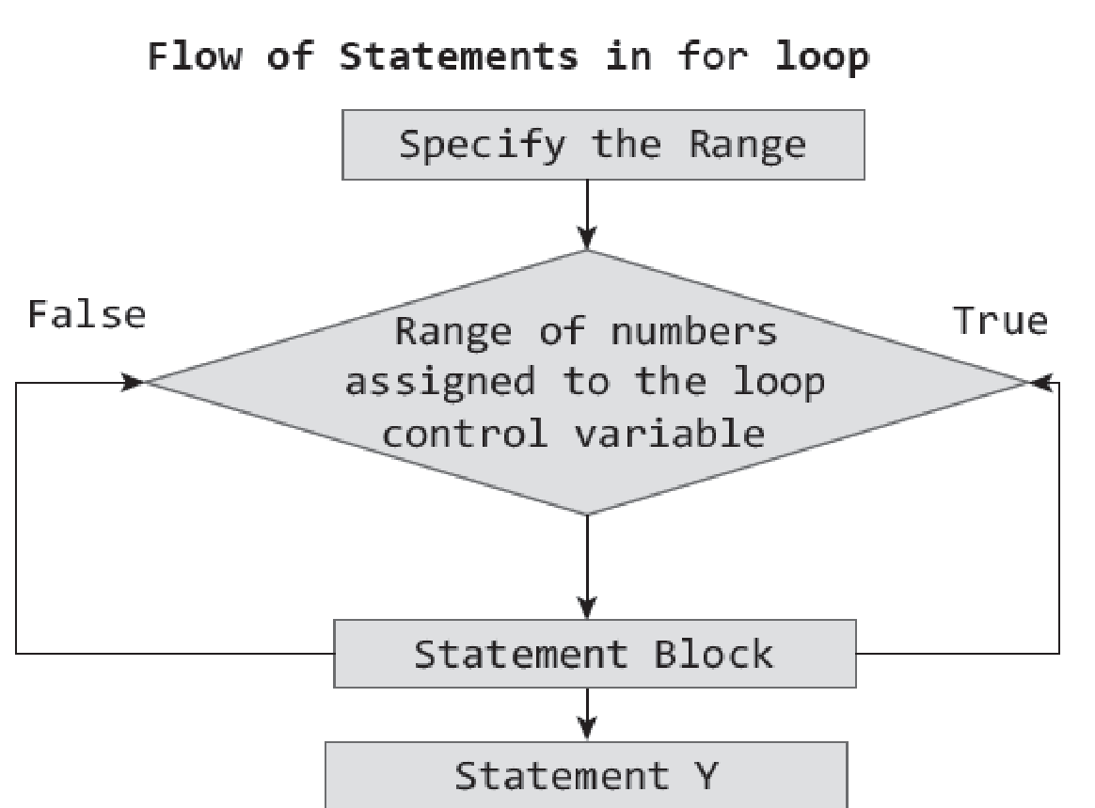
For Loop
For loop provides a mechanism to repeat a task until a particular condition is True. It is usually known as a determinate or definite loop because the programmer knows exactly how many times the loop will repeat.
The for...in statement is a looping statement used in Python to iterate over a sequence of objects.

Slide 41
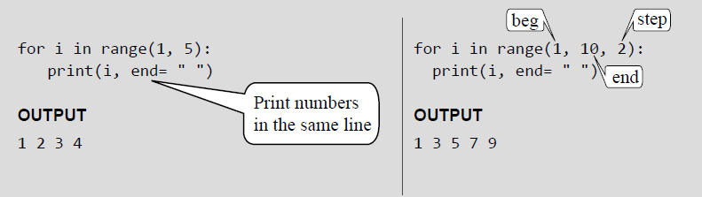
For Loop and Range() Function
The range() function is a built-in function in Python that is used to iterate over a sequence of numbers. The syntax of range() is range(beg, end, [step])
The range() produces a sequence of numbers starting with beg (inclusive) and ending with one less than the number end. The step argument is option (that is why it is placed in brackets). By default, every number in the range is incremented by 1 but we can specify a different increment using step. It can be both negative and positive, but not zero.
Examples:

Slide 42
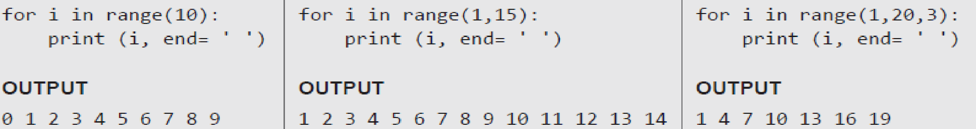
Range() Function
If range() function is given a single argument, it produces an object with values from 0 to argument-1. For example: range(10) is equal to writing range(0, 10).
If range() is called with two arguments, it produces values from the first to the second. For example, range(0,10).
If range() has three arguments then the third argument specifies the interval of the sequence produced. In this case, the third argument must be an integer. For example, range(1,20,3).
Examples:

Slide 43
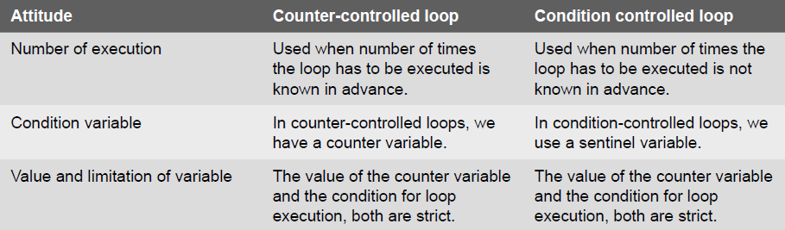
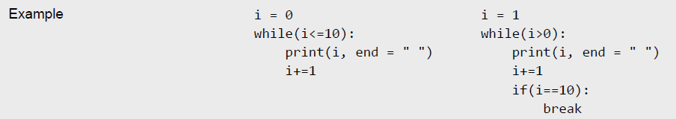
Condition-controlled and Counter-controlled Loops

Slide 44
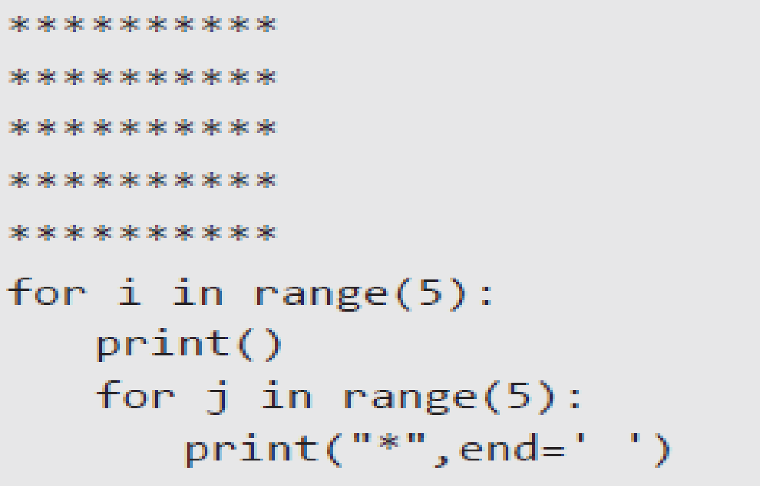
Nested Loops
Python allows its users to have nested loops, that is, loops that can be placed inside other loops. Although this feature will work with any loop like while loop as well as for loop.
A for loop can be used to control the number of times a particular set of statements will be executed. Another outer loop could be used to control the number of times that a whole loop is repeated.
Loops should be properly indented to identify which statements are contained within each for statement.
Example:

Slide 45
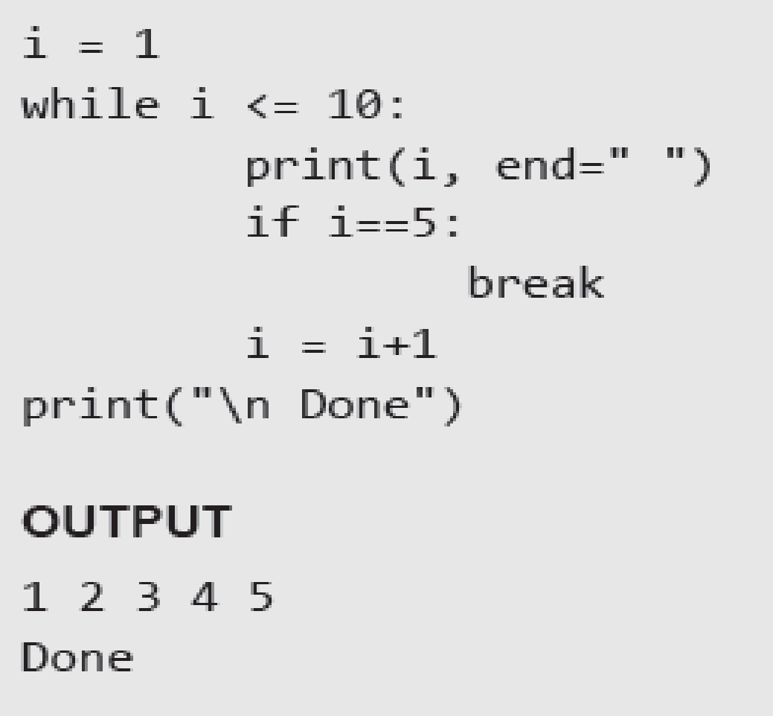
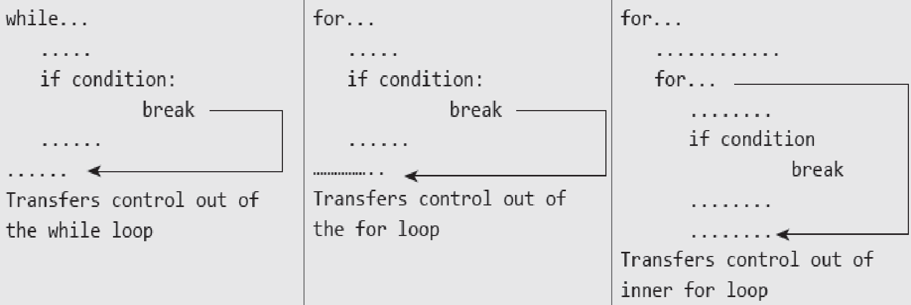
The Break Statement
The break statement is used to terminate the execution of the nearest enclosing loop in which it appears. The break statement is widely used with for loop and while loop. When compiler encounters a break statement, the control passes to the statement that follows the loop in which the break statement appears.
Example:

Slide 46
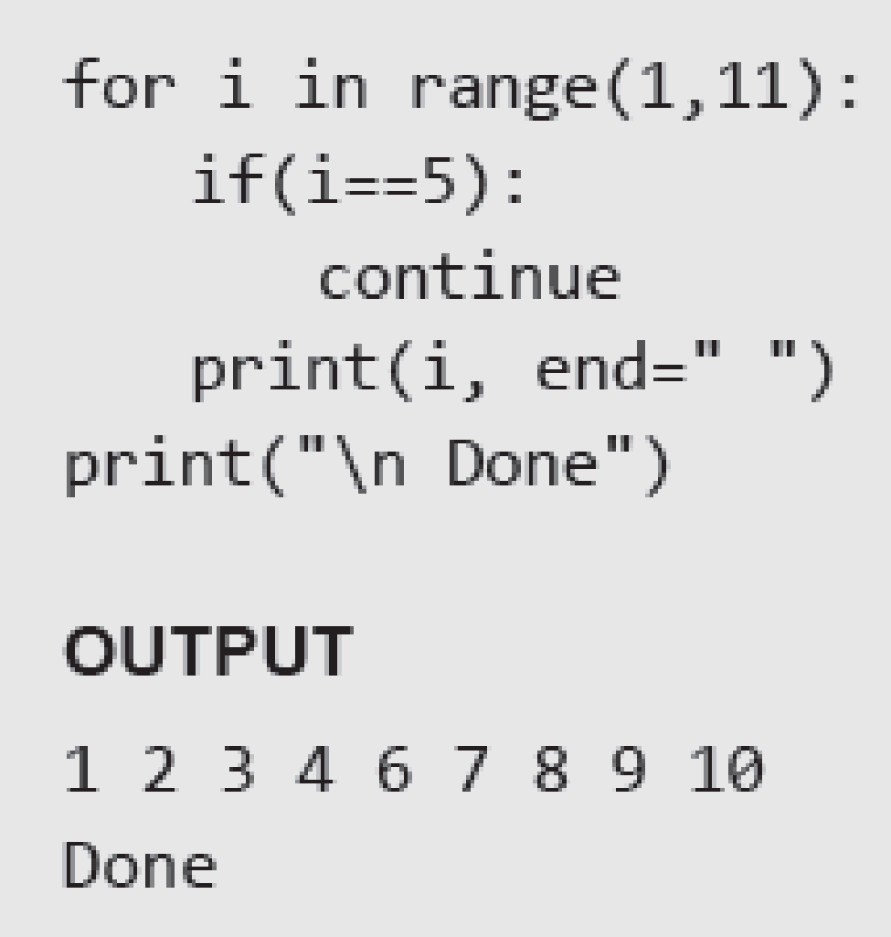
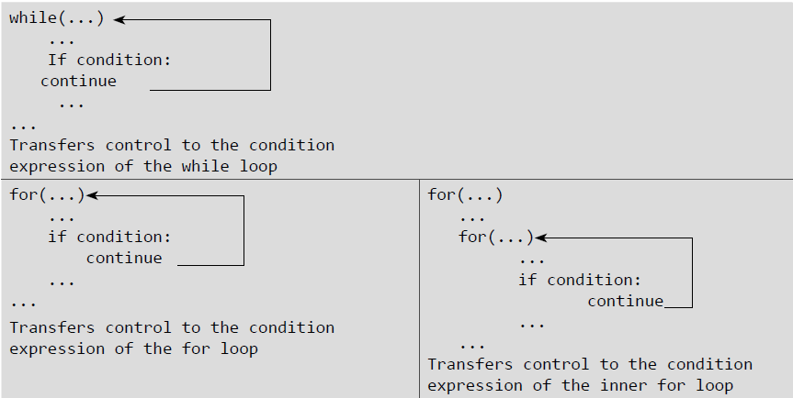
The Continue Statement
Like the break statement, the continue statement can only appear in the body of a loop. When the compiler encounters a continue statement then the rest of the statements in the loop are skipped and the control is unconditionally transferred to the loop-continuation portion of the nearest enclosing loop.
Example:

Slide 47
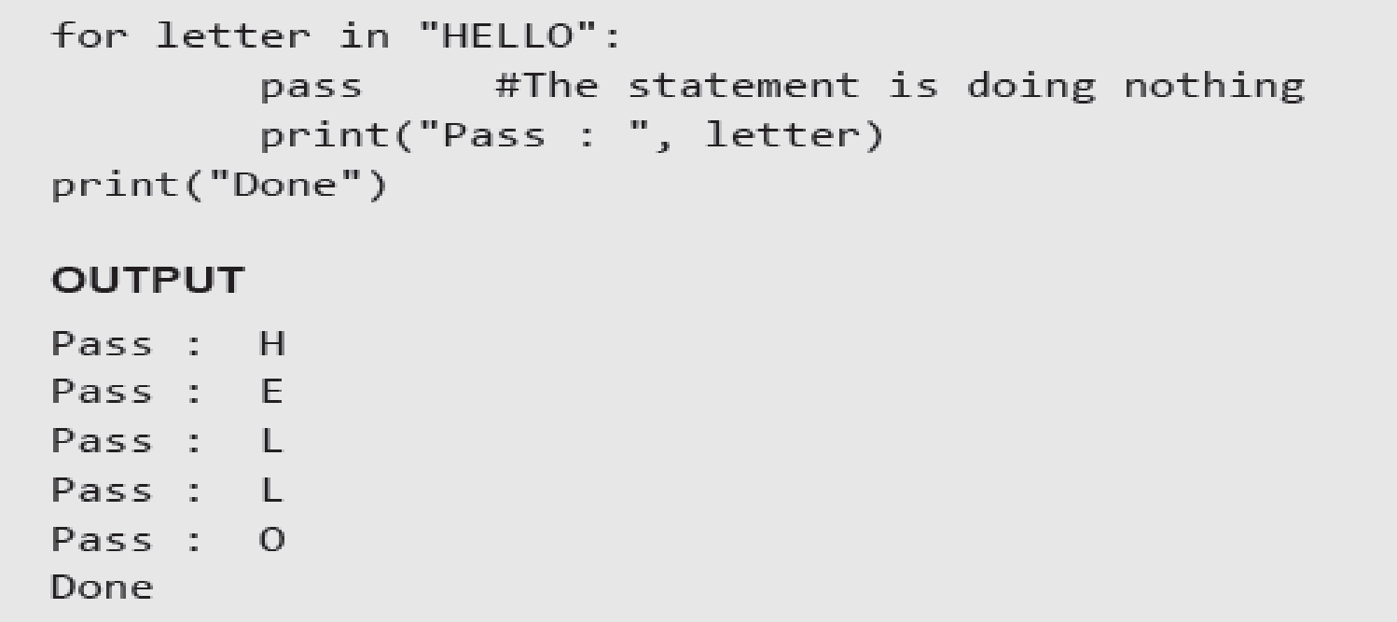
The Pass Statement
Pass statement is used when a statement is required syntactically but no command or code has to be executed. It specified a null operation or simply No Operation (NOP) statement. Nothing happens when the pass statement is executed.
Difference between comment and pass statements In Python programming, pass is a null statement. The difference between a comment and pass statement is that while the interpreter ignores a comment entirely, pass is not ignored. Comment is not executed but pass statement is executed but nothing happens.
Example:

Slide 48

The Else Statement Used With Loops
Unlike C and C++, in Python you can have the else statement associated with a loop statement. If the else statement is used with a for loop, the else statement is executed when the loop has completed iterating. But when used with the while loop, the else statement is executed when the condition becomes false.
Example:

Slide 49
Functions and Modules

Slide 50


Functions
Python enables its programmers to break up a program into segments commonly known as functions, each of which can be written more or less independently of the others. Every function in the program is supposed to perform a well-defined task.

Slide 51

Need for Functions
Each function to be written and tested separately.
Understanding, coding and testing multiple separate functions is far easier.
Without the use of any function, then there will be countless lines in the code and maintaining it will be a big mess.
Programmers use functions without worrying about their code details. This speeds up program development, by allowing the programmer to concentrate only on the code that he has to write.
Different programmers working on that project can divide the workload by writing different functions.
Like Python libraries, programmers can also make their functions and use them from different point in the main program or any other program that needs its functionalities.

Slide 52
Function Declaration and Definition
A function, f that uses another function g, is known as the calling function and g is known as the called function.
The inputs that the function takes are known as arguments/parameters.
When a called function returns some result back to the calling function, it is said to return that result.
The calling function may or may not pass parameters to the called function. If the called function accepts arguments, the calling function will pass parameters, else not.
Function declaration is a declaration statement that identifies a function with its name, a list of arguments that it accepts and the type of data it returns.
Function definition consists of a function header that identifies the function, followed by the body of the function containing the executable code for that function.

Slide 53

Function Definition
Function blocks starts with the keyword def.
The keyword is followed by the function name and parentheses (( )).
After the parentheses a colon (:) is placed.
Parameters or arguments that the function accept are placed within parentheses.
The first statement of a function can be an optional statement - the docstring describe what the function does.
The code block within the function is properly indented to form the block code.
A function may have a return[expression] statement. That is, the return statement is optional.
You can assign the function name to a variable. Doing this will allow you to call same function using the name of that variable.

Slide 54

Function Call
The function call statement invokes the function. When a function is invoked the program control jumps to the called function to execute the statements that are a part of that function. Once the called function is executed, the program control passes back to the calling function.
Function Parameters:
A function can take parameters which are nothing but some values that are passed to it so that the function can manipulate them to produce the desired result. These parameters are normal variables with a small difference that the values of these variables are defined (initialized) when we call the function and are then passed to the function.
Function name and the number and type of arguments in the function call must be same as that given in the function definition.
If the data type of the argument passed does not matches with that expected in function then an error is generated.
Example:

Slide 55




Examples

Slide 56
Local and Global Variables
A variable which is defined within a function is local to that function. A local variable can be accessed from the point of its definition until the end of the function in which it is defined. It exists as long as the function is executing. Function parameters behave like local variables in the function. Moreover, whenever we use the assignment operator (=) inside a function, a new local variable is created.
Global variables are those variables which are defined in the main body of the program file. They are visible throughout the program file. As a good programming habit, you must try to avoid the use of global variables because they may get altered by mistake and then result in erroneous output.

Slide 57

Local and Global Variables
Example:

Slide 58

Using the Global Statement
To define a variable defined inside a function as global, you must use the global statement. This declares the local or the inner variable of the function to have module scope.
Example:

Slide 59

Resolution of Names
Scope defines the visibility of a name within a block. If a local variable is defined in a block, its scope is that particular block. If it is defined in a function, then its scope is all blocks within that function.
When a variable name is used in a code block, it is resolved using the nearest enclosing scope. If no variable of that name is found, then a NameError is raised. In the code given below, str is a global string because it has been defined before calling the function.
Example:

Slide 60

The Return Statement
The syntax of return statement is, return [expression]
The expression is written in brackets because it is optional. If the expression is present, it is evaluated and the resultant value is returned to the calling function. However, if no expression is specified then the function will return None.
The return statement is used for two things.
• Return a value to the caller
• To end and exit a function and go back to its caller
Example:

Slide 61

Required Arguments
In the required arguments, the arguments are passed to a function in correct positional order. Also, the number of arguments in the function call should exactly match with the number of arguments specified in the function definition

Slide 62

Keyword Arguments
When we call a function with some values, the values are assigned to the arguments based on their position. Python also allow functions to be called using keyword arguments in which the order (or position) of the arguments can be changed. The values are not assigned to arguments according to their position but based on their name (or keyword).
Keyword arguments are beneficial in two cases.
• First, if you skip arguments.
• Second, if in the function call you change the order of parameters.
Example:

Slide 63


Variable-length Arguments
In some situations, it is not known in advance how many arguments will be passed to a function. In such cases, Python allows programmers to make function calls with arbitrary (or any) number of arguments.
When we use arbitrary arguments or variable length arguments, then the function definition use an asterisk (*) before the parameter name. The syntax for a function using variable arguments can be given as,
Example:

Slide 64

Default Arguments
Python allows users to specify function arguments that can have default values. This means that a function can be called with fewer arguments than it is defined to have. That is, if the function accepts three parameters, but function call provides only two arguments, then the third parameter will be assigned the default (already specified) value.
The default value to an argument is provided by using the assignment operator (=). Users can specify a default value for one or more arguments.
Example:

Slide 65


Lambda Functions or Anonymous Functions
Lambda or anonymous functions are so called because they are not declared as other functions using the def keyword. Rather, they are created using the lambda keyword. Lambda functions are throw-away functions, i.e. they are just needed where they have been created and can be used anywhere a function is required. The lambda feature was added to Python due to the demand from LISP programmers.
Lambda functions contain only a single line. Its syntax can be given as,
Example:

Slide 66


Documentation Strings
Docstrings (documentation strings) serve the same purpose as that of comments, as they are designed to explain code. However, they are more specific and have a proper syntax.
Example:

Slide 67

Recursive Functions
A recursive function is defined as a function that calls itself to solve a smaller version of its task until a final call is made which does not require a call to itself. Every recursive solution has two major cases, which are as follows:
base case, in which the problem is simple enough to be solved directly without making any further calls to the same function.
recursive case, in which first the problem at hand is divided into simpler sub parts.
Recursion utilized divide and conquer technique of problem solving.
Example:

Slide 68


The from…import Statement
A module may contain definition for many variables and functions. When you import a module, you can use any variable or function defined in that module. But if you want to use only selected variables or functions, then you can use the from...import statement. For example, in the aforementioned program you are using only the path variable in the sys module, so you could have better written from sys import path.
Example:
To import more than one item from a module, use a comma separated list. For example, to import the value of pi and sqrt() from the math module you can write,

Slide 69

Making your own Modules
Every Python program is a module, that is, every file that you save as .py extension is a module.
Examples:

Slide 70

The dir() function
dir() is a built-in function that lists the identifiers defined in a module. These identifiers may include functions, classes and variables. If no name is specified, the dir() will return the list of names defined in the current module.
Example:

Slide 71

Modules and Namespaces
A namespace is a container that provides a named context for identifiers. Two identifiers with the same name in the same scope will lead to a name clash. In simple terms, Python does not allow programmers to have two different identifiers with the same name. However, in some situations we need to have same name identifiers. To cater to such situations, namespaces is the keyword. Namespaces enable programs to avoid potential name clashes by associating each identifier with the namespace from which it originates.
Example:

Slide 72
Local, Global, and Built-in Namespaces
During a program’s execution, there are three main namespaces that are referenced- the built-in namespace, the global namespace, and the local namespace. The built-in namespace, as the name suggests contains names of all the built-in functions, constants, etc that are already defined in Python. The global namespace contains identifiers of the currently executing module and the local namespace has identifiers defined in the currently executing function (if any).
When the Python interpreter sees an identifier, it first searches the local namespace, then the global namespace, and finally the built-in namespace. Therefore, if two identifiers with same name are defined in more than one of these namespaces, it becomes masked.

Slide 73


Local, Global, and Built-in Namespaces
Example:

Slide 74
Module Private Variables
In Python, all identifiers defined in a module are public by default. This means that all identifiers are accessible by any other module that imports it. But, if you want some variables or functions in a module to be privately used within the module, but not to be accessed from outside it, then you need to declare those identifiers as private.
In Python identifiers whose name starts with two underscores (__) are known as private identifiers. These identifiers can be used only within the module. In no way, they can be accessed from outside the module. Therefore, when the module is imported using the import * form modulename, all the identifiers of a module’s namespace is imported except the private ones (ones beginning with double underscores). Thus, private identifiers become inaccessible from within the importing module.

Slide 75
Packages in Python
A package is a hierarchical file directory structure that has modules and other packages within it. Like modules, you can very easily create packages in Python.
Every package in Python is a directory which must have a special file called __init__.py. This file may not even have a single line of code. It is simply added to indicate that this directory is not an ordinary directory and contains a Python package. In your programs, you can import a package in the same way as you import any module.
For example, to create a package called MyPackage, create a directory called MyPackage having the module MyModule and the __init__.py file. Now, to use MyModule in a program, you must first import it. This can be done in two ways.
import MyPackage.MyModule (or)
from MyPackage import MyModule

Slide 76
Globals(), Locals(), And Reload()
The globals() and locals() functions are used to return the names in the global and local namespaces (In Python, each function, module, class, package, etc owns a “namespace” in which variable names are identified and resolved). The result of these functions is of course, dependent on the location from where they are called. For example,
If locals() is called from within a function, names that can be accessed locally from that function will be returned.
If globals() is called from within a function, all the names that can be accessed globally from that function is returned.
Reload()- When a module is imported into a program, the code in the module is executed only once. If you want to re-execute the top-level code in a module, you must use the reload() function. This function again imports a module that was previously imported.

Slide 77
Python Strings Revisited

Slide 78
Strings
Python treats strings as contiguous series of characters delimited by single, double or even triple quotes. Python has a built-in string class named "str" that has many useful features. We can simultaneously declare and define a string by creating a variable of string type. This can be done in several ways which are as follows:
name = "India" graduate = 'N' country = name nationality = str("Indian")
Indexing: Individual characters in a string are accessed using the subscript ([ ]) operator. The expression in brackets is called an index. The index specifies a member of an ordered set and in this case it specifies the character we want to access from the given set of characters in the string.
The index of the first character is 0 and that of the last character is n-1 where n is the number of characters in the string. If you try to exceed the bounds (below 0 or above n-1), then an error is raised.

Slide 79

Strings
Traversing a String: A string can be traversed by accessing character(s) from one index to another. For example, the following program uses indexing to traverse a string from first character to the last.
Example:

Slide 80



Concatenating, Appending and Multiplying Strings
Examples:

Slide 81


Strings are Immutable
Python strings are immutable which means that once created they cannot be changed. Whenever you try to modify an existing string variable, a new string is created.
Example:

Slide 82

Strings Formatting Operator
The % operator takes a format string on the left (that has %d, %s, etc) and the corresponding values in a tuple (will be discussed in subsequent chapter) on the right. The format operator, % allow users to construct strings, replacing parts of the strings with the data stored in variables. The syntax for the string formatting operation is:
"<Format>" % (<Values>)
Example:

Slide 83


Built-in String Methods and Functions

Slide 84

Built-in String Methods and Functions

Slide 85

Built-in String Methods and Functions

Slide 86


Slice Operation
A substring of a string is called a slice. The slice operation is used to refer to sub-parts of sequences and strings. You can take subset of string from original string by using [ ] operator also known as slicing operator.
Example:

Slide 87

Specifying Stride while Slicing Strings
In the slice operation, you can specify a third argument as the stride, which refers to the number of characters to move forward after the first character is retrieved from the string. By default the value of stride is 1, so in all the above examples where he had not specified the stride, it used the value of 1 which means that every character between two index numbers is retrieved.
Example:

Slide 88


ord() and chr() Functions
ord() function returns the ASCII code of the character and chr() function returns character represented by a ASCII number.
Example:
In and not in Operators: in and not in operators can be used with strings to determine whether a string is present in another string. Therefore, the in and not in operator are also known as membership operators.
Examples:

Slide 89

Comparing Strings

Slide 90


Iterating String
String is a sequence type (sequence of characters). You can iterate through the string using for loop.
Examples:

Slide 91

The String Module
The string module consist of a number of useful constants, classes and functions (some of which are deprecated). These functions are used to manipulate strings.
Example:

Slide 92

Working with Constants in String Module
You can use the constants defined in the string module along with the find function to classify characters. For example, if find(lowercase, ch) returns a value except -1, then it means that ch must be a lowercase character. An alternate way to do the same job is to use the in operator or even the comparison operation.
Example:

Slide 93
Regular Expressions
Regular Expressions are a powerful tool for various kinds of string manipulation. These are basically a special text string that is used for describing a search pattern to extract information from text such as code, files, log, spreadsheets, or even documents.
Regular expressions are a domain specific language (DSL) that is present as a library in most of the modern programming languages, besides Python. A regular expression is a special sequence of characters that helps to match or find strings in another string. In Python, regular expressions can be accessed using the re module which comes as a part of the Standard Library
The Match Function
As the name suggest, the match() function matches a pattern to string with optional flags. The syntax of match() function is, re.match (pattern, string, flags=0)

Slide 94


Example- Match() Function
Examples:

Slide 95

The search Function
The search() function in the re module searches for a pattern anywhere in the string. Its syntax of can be given as, re.search(pattern, string, flags=0)
The syntax is similar to the match() function. The function searches for first occurrence of pattern within a string with optional flags. If the search is successful, a match object is returned and None otherwise.
Example:

Slide 96

The sub() Function
The sub() function in the re module can be used to search a pattern in the string and replace it with another pattern. The syntax of sub() function can be given as, re.sub(pattern, repl, string, max=0)
According to the syntax, the sub() function replaces all occurrences of the pattern in string with repl, substituting all occurrences unless any max value is provided. This method returns modified string.
Example:

Slide 97

The findall() and finditer() Function
The findall() function is used to search a string and returns a list of matches of the pattern in the string. If no match is found, then the returned list is empty. The syntax of match() function can be given as, matchList = re.findall(pattern, input_str, flags=0)
Example:

Slide 98
Flag Options
The search(), findall() and match() functions of the module take options to modify the behavior of the pattern match. Some of these flags are:
re.I or re.IGNORECASE — Ignores case of characters, so "Match", "MATCH", "mAtCh", etc are all same
re.S or re.DOTALL — Enables dot (.) to match newline. By default, dot matches any character other than the newline character.
re.M or re.MULTILINE — Makes the ^ and $ to match the start and end of each line. That is, it matches even after and before line breaks in the string. By default, ^ and $ matches the start and end of the whole string.
re.L or re.LOCALE- Makes the flag \w to match all characters that are considered letters in the given current locale settings.
re.U or re.UNICODE- Treats all letters from all scripts as word characters.

Slide 99

Metacharacters in Regular Expression

Slide 100

Metacharacters in Regular Expression

Slide 101

Character Classes
When we put the characters to be matched inside square brackets, we call it a character class. For example, [aeiou] defines a character class that has a vowel character.
Example:

Slide 102

Groups
A group is created by surrounding a part of the regular expression with parentheses. You can even give group as an argument to the metacharacters such as * and ?.
Example:
The content of groups in a match can be accessed by using the group() function. For example,
group(0) or group() returns the whole match.
group(n), where n is greater than 0, returns the nth group from the left.
group() returns all groups up from 1.

Slide 103
Thank you

